Slide 1
CompTIA A+ Certification 801 Support Skills
Unit 1.1 Safety Procedures

Slide 2
Understand safety procedures for dealing with hazards associated with PC support
Use procedures and tools to reduce the risk of ESD damage when handling computer components
Identify appropriate disposal methods for waste equipment
Unit 1.1 Safety Procedures
Slide <number>

Slide 3
Health and Safety Laws
Responsibilities
  Employer
  Employee
Health and safety handbook
  Emergencies
  Responsible persons
  Hazardous areas
  Best practice
  Incident reporting
Unit 1.1 Safety Procedures
Slide <number>

Slide 4
Emergency Procedures
Raise the alarm / alert emergency services
Establish your escape route
Make the scene safe
Tackle the emergency
  If it is SAFE
  If you are TRAINED
  Fire-fighting
  First aid
Unit 1.1 Safety Procedures
Slide <number>

Slide 5
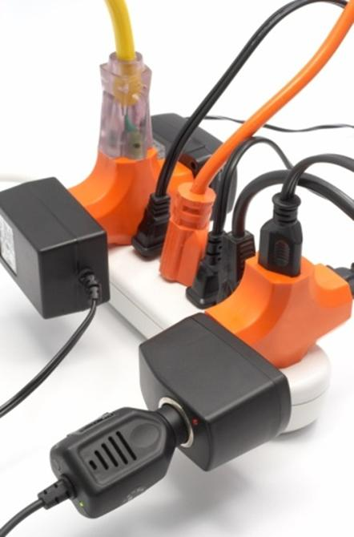
Electrical Safety
Danger or electric shock
Portable Appliance Testing
Fuse ratings
Strip sockets
Surge suppression
Equipment grounding
Unit 1.1 Safety Procedures
Slide <number>

Slide 6
Personal Safety
Disconnect power source
Use insulated tools
“Hand in pocket” rule
Remove jewelery
High-voltage components / capacitors - do not disassemble CRTs, PSUs, etc
Electrical fire safety
Unit 1.1 Safety Procedures
Slide <number>

Slide 7
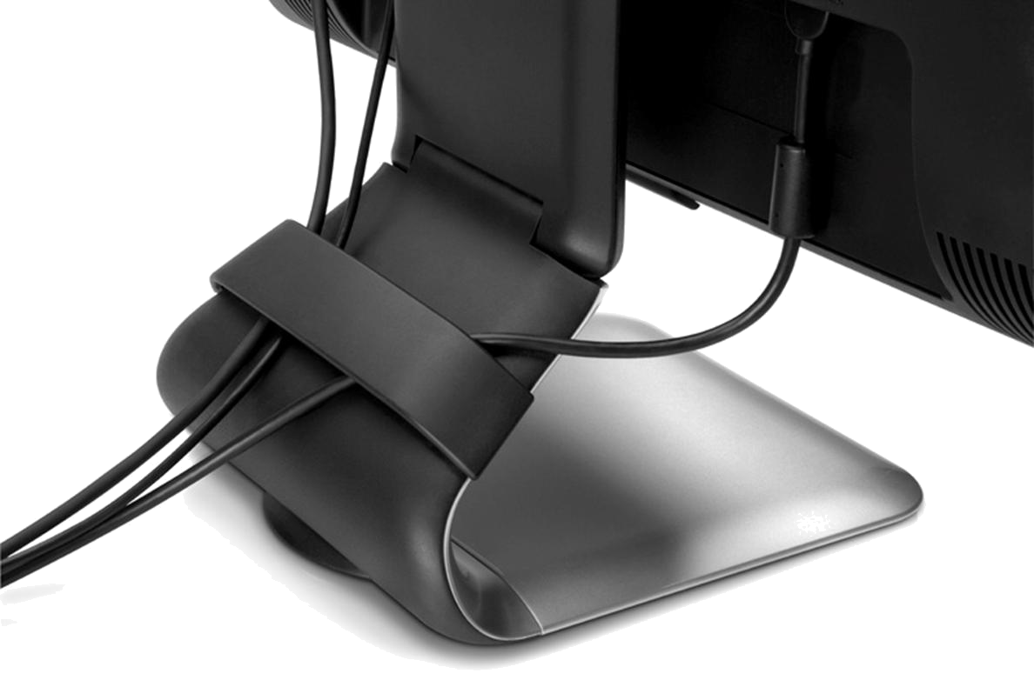
Other Hazards
Cable management and trip hazards
Lifting and manual handling
  Protect your back
  Heavy objects
  Awkward objects
Thermal hazards
Unit 1.1 Safety Procedures
Slide <number>

Slide 8
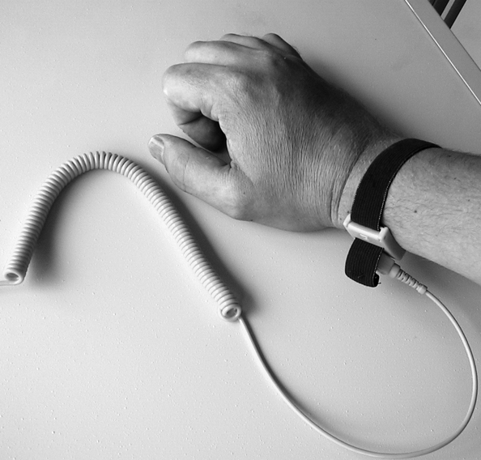
Static Electricity and ESD
High voltage potential difference
Electrostatic Discharge (ESD)
  Clothing
  Climate
  Effect on transistors
Anti-static protection
Unit 1.1 Safety Procedures
Slide <number>

Slide 9
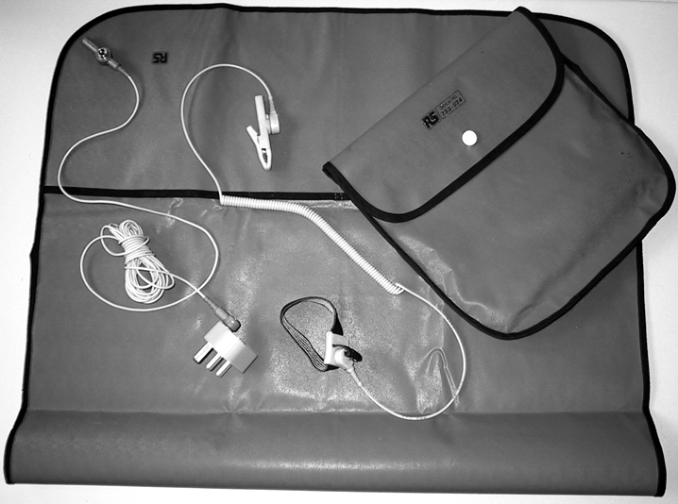
Anti-ESD Service Kit
Wrist strap for self-grounding
Test wrist straps to ensure current-limiting resistor works
Mat to place components on
Connect via grounding plug or clip to metal part of chassis
Unit 1.1 Safety Procedures
Slide <number>

Slide 10
Understand safety procedures for dealing with hazards associated with PC support
Use procedures and tools to reduce the risk of ESD damage when handling computer components
Identify appropriate disposal methods for waste equipment
Unit 1.1 Safety Procedures
Slide <number>

Slide 11
Lab 1 Implementing an Anti-ESD Service Kit
Unit 1.1 Safety Procedures
Slide <number>

